Slide 1
Music Genre Classification
Toluwani, Finn, Safwan

Slide 2



Intro
Using the GTZAN Genre Collection.
10 genres (Blues, Classical, Country, Disco, Hip-hop, Jazz, Metal, Pop, Reggae, Rock), with 100 tracks per genre.
ML Models
Librosa
Traditional signal processing approach
Image based
Convert the audio clips into spectrograms and train neural network to classify the genre using sound patterns
Modern deep learning approach

Slide 3
Milestones
Milestone 1: Data Architecture & Preprocessing | Validate 1,000 GTZAN tracks; handle corrupted .au files (e.g., jazz.00054). Implement a stratified 70/15/15 split to ensure genre balance across training and testing.
Milestone 2: Multi-Dimensional Feature Engineering | Extract acoustic "fingerprints" using Librosa. Key metrics: MFCCs (timbre), Spectral Centroid (brightness), Chroma (harmony), and RMS Energy (amplitude). Export to structured CSV.
Milestone 3: Traditional ML & Baseline Performance | Benchmark classification using Random Forest and SVM. Apply StandardScaler for normalization. Evaluate via Confusion Matrices to identify "style-overlap" (e.g., Rock vs. Metal).
Milestone 4: Deep Learning & Neural Architectures | Convert audio to Mel-Spectrograms (image-based sound). Train a Convolutional Neural Network (CNN) to "see" musical patterns, leveraging computer vision for higher accuracy.
Milestone 5: AI vs. Human Discriminator | Pivot to binary classification. Train the model on a new dataset of Suno/Udio (AI) vs. GTZAN (Human) to identify "spectral artifacts" unique to generated audio.

Slide 4
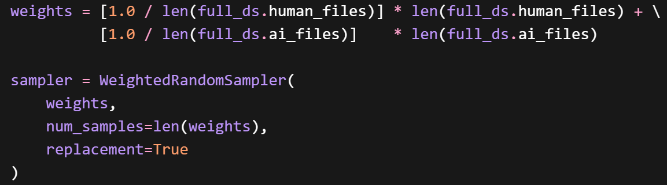
Data Limitations
Human made music data set – GTZAN ~1000 files
AI-generated music - Suno/Udio ~160 files
*Weighted sampling compensates for the imbalance between 1,000 human tracks and 163 AI tracks.
Notes:
The Goal: Explain the bottleneck in your dataset and how you programmatically solved it.
"Moving into our data architecture, we immediately ran into a significant class imbalance. While we had about 1,000 human-made tracks from the GTZAN dataset , our AI-generated dataset from Suno and Udio was limited to around 160 files. If we trained on this directly, the model would inherently bias toward predicting human audio. To fix this, we implemented a WeightedRandomSampler in PyTorch, heavily weighting the AI samples to artificially balance the dataset during the training phase."

Slide 5
Initial Results
Model predicted 100% AI for all inputs despite correct genre outputs
Root debugging steps uncovered issues like silent audio input (FFmpeg) and architecture mismatches
Switching to a hybrid approach
Result improved from 100% AI to ~75% Human / 25% AI on real songs (partial but meaningful progress)
Notes:
The Goal: Be transparent about the initial failure. It highlights your troubleshooting process.
"Despite balancing the data, our initial testing was completely broken. While the model was outputting correct genres, it was predicting 100% AI for every single input track we gave it. We stepped back and started root-cause debugging, uncovering issues ranging from silent audio inputs caused by FFmpeg to deeper architecture mismatches. By switching to a hybrid approach, we managed to push the results from 100% AI to a 75% Human and 25% AI split on real songs, which was a partial, but meaningful step in the right direction."

Slide 6
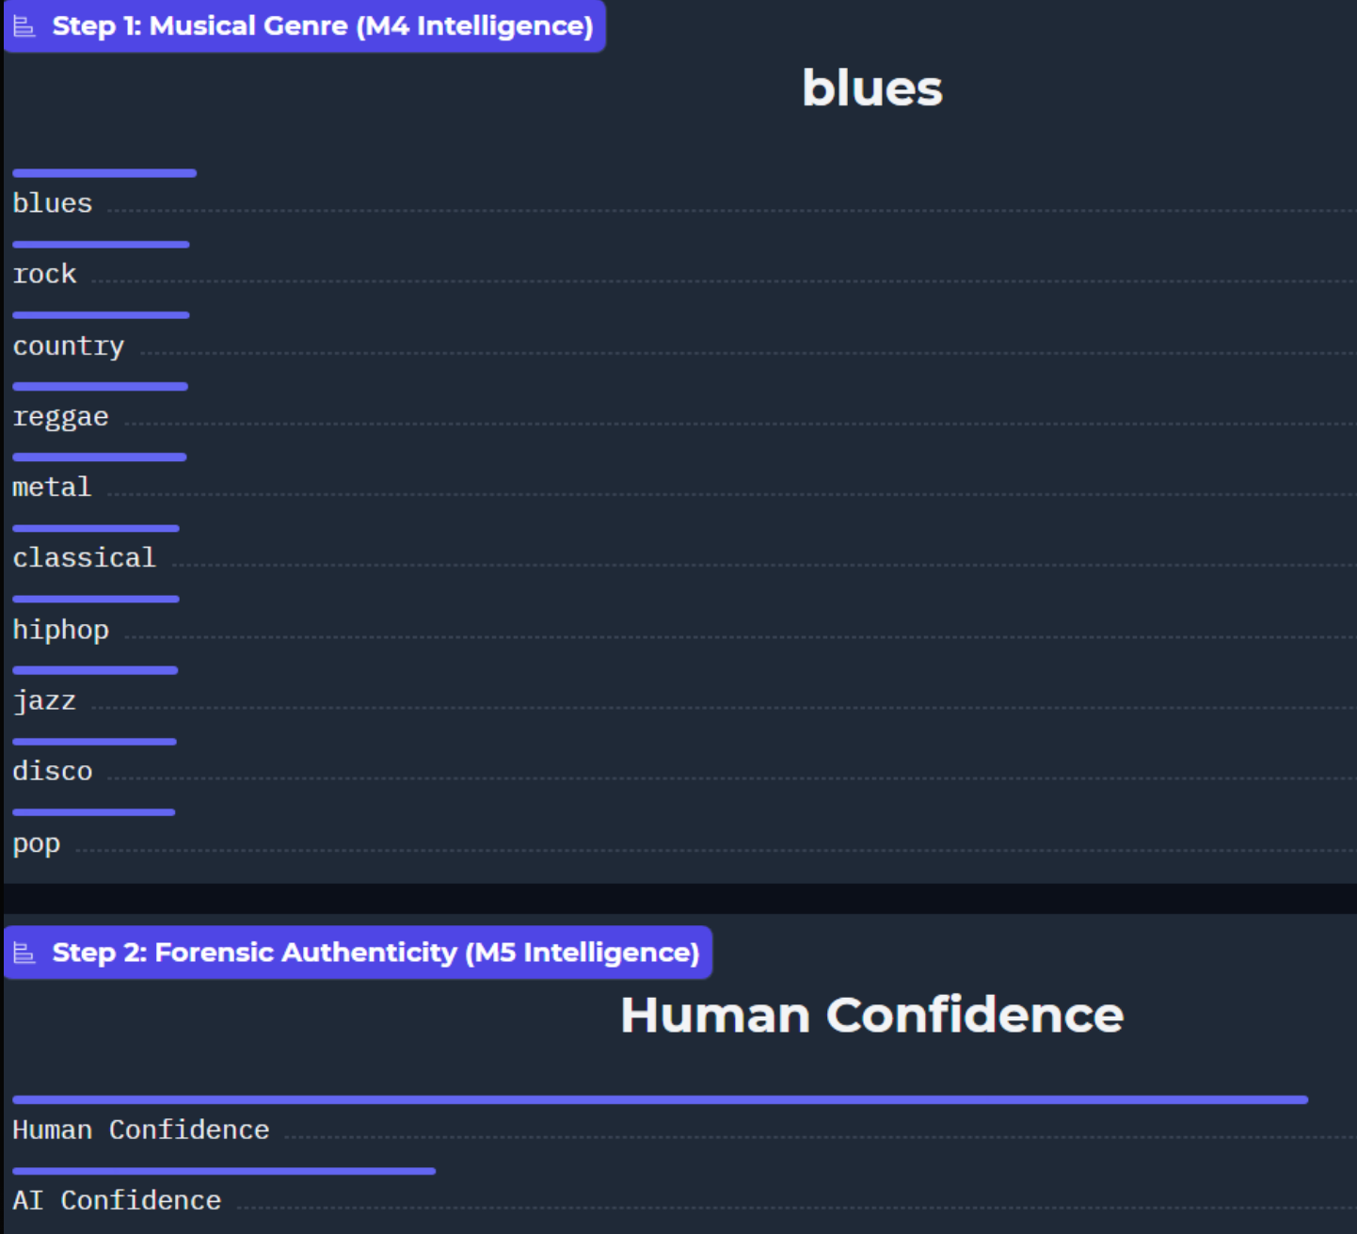
Notes:
The Goal: Briefly establish the two-pronged nature of the system before diving into the deep failure analysis.
"This slide visualizes the dual-intelligence pipeline we were aiming for. Step 1 handles the Musical Genre classification—sorting into categories like blues, rock, country, and classical. Step 2 runs in parallel as a Forensic Authenticity check, which outputs the final confidence scores for whether the track is Human or AI."

Slide 7
Model Failure Analysis
Content:
Misclassification at high confidence
AI Hip-Hop → Classical (97%)
Human → AI (95%+)
Root Issues:
Double normalization
Training ≠ inference pipeline
Heuristic overrides interfering
Only first 30s analyzed
*Model was learning the wrong signals due to preprocessing and pipeline mismatch.
Notes:
The Goal: Dive into the technical meat of why the initial runs failed.
"When we audited the misclassifications, the errors were happening at extremely high confidence levels. For example, AI Hip-Hop was being flagged as Classical with 97% confidence , and actual Human tracks were being flagged as AI with over 95% confidence. We traced this back to a massive pipeline mismatch between our training and inference environments. We were applying double normalization, our heuristic overrides were interfering with the raw outputs, and we were only analyzing the first 30 seconds of a track. Essentially, because of these preprocessing bugs, the model was learning completely wrong signals."

Slide 8
Solution
Content:
Fixed normalization logic
Trained on raw audio (matched inference)
Removed all heuristics
Full-track multi-window analysis
Result:
Human: 0.00–0.20
AI: 0.40–1.00
Clean separation
Notes:
The Goal: Present the clean resolution and the final metrics that prove your fix worked.
"To solve this, we completely rebuilt the pipeline to ensure inference matched training perfectly. We fixed the normalization logic, stripped out all the heuristic overrides, trained exclusively on raw audio, and shifted to a full-track multi-window analysis. The result was a totally clean separation. Human tracks reliably score between 0.00 and 0.20, while AI-generated tracks consistently score between 0.40 and 1.00."

Slide 9
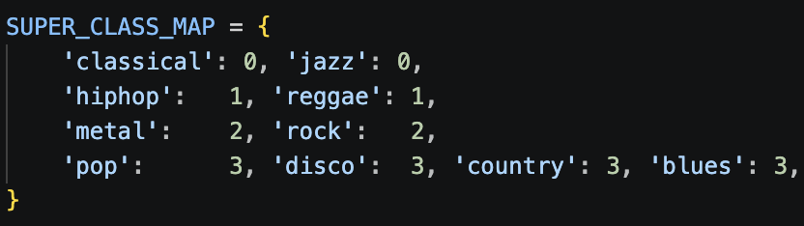
Genre Combination
Class 0 (Acoustic) - Acoustic arrangements meet clean harmonic overtones to help the model identify natural resonance and high dynamic range.
Class 1 (Rhythmic) - Rhythmic backbeats align with bottom-heavy spectral energy (20 to 200 Hz) to isolate transient kick and bass peaks.
Class 2 (Aggressive) - Aggressive guitar distortion and busy drumming create a saturated, full-spectrum "wall of noise" that defines this high-energy class.
Class 3 (Melodic) - Vocal-centric verse-chorus structures utilize a strong mid-range spectral presence to help the model locate the signature "vocal pocket."

Slide 10

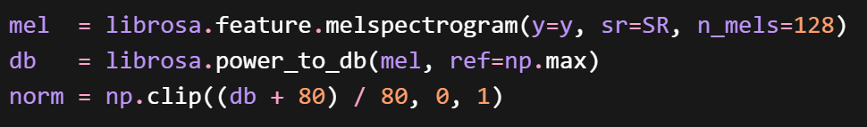
Key Training Decisions
Original issue:
Human files were raw dB values: -80 to 0
AI files were already normalized: 0 to 1
Same normalization was applied to two different data formats, causing AI files to become almost all-white.
Training now uses the same raw-audio preprocessing pipeline as inference.

Slide 11
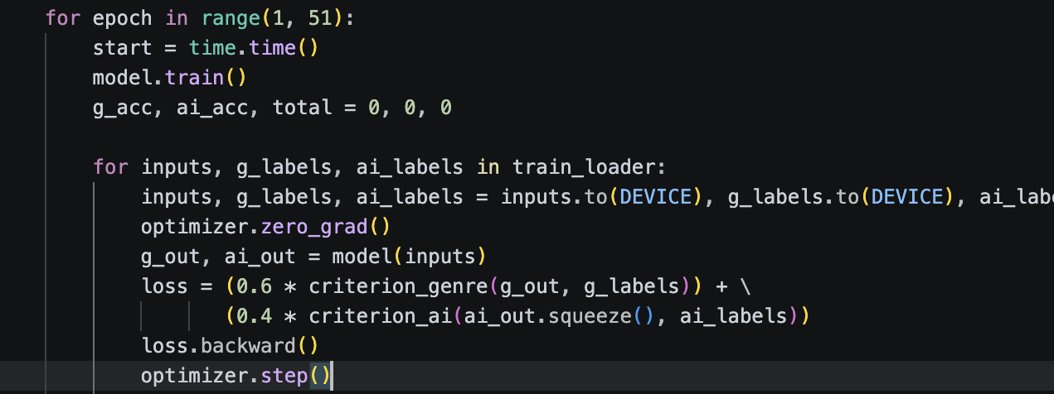
Classification vs Analysis Value
60/40 split

Slide 12
Temporal Variation
Full-track windowed analysis splits the audio into 30-second chunks and runs the model on each independently, so if hip-hop kicks in at 1:00, that window votes separately from the classical intro at 0:00.
Averaged forensic scores mean a song that is half AI and half human will land somewhere in the middle, if the AI section scores 0.80 and the human section scores 0.10, the averaged score of ~0.45 sits just below the default 0.50 threshold, which is the honest answer for a mixed-origin track.
Genre probabilities are also averaged across windows, so the final genre label reflects the dominant character of the whole track rather than just whichever style happened to open the song.

Slide 13
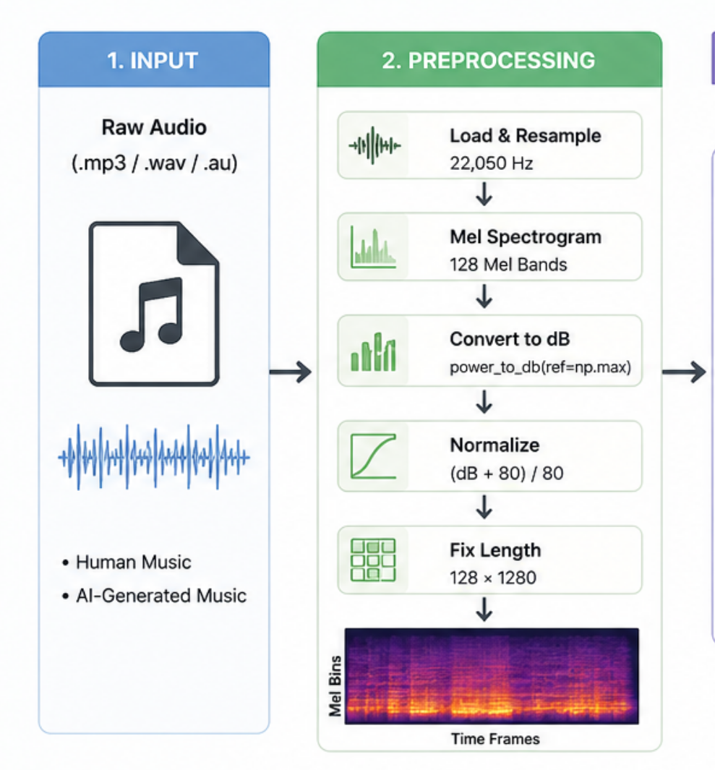
Final System Architecture

Slide 14
Functional Description
Load at 22,050 Hz: the system samples the audio 22,050 times per second, which is the standard quality level for music analysis
128 Mel Bands: instead of looking at every individual frequency, the system groups them into 128 buckets that match how human ears hear low frequencies get more buckets, high frequencies fewer
Convert to dB: translates raw sound energy into the decibel scale humans use (like volume levels), making quiet and loud parts easier to compare
Normalize: scales everything into a 0–1 range so the model isn't thrown off by tracks that are just louder or quieter than others
128 × 1280 grid: the final result is a fixed-size image of the sound: 128 frequency levels tall, 1,280 time slices wide, every track gets the same dimensions regardless of how it was recorded

Slide 15
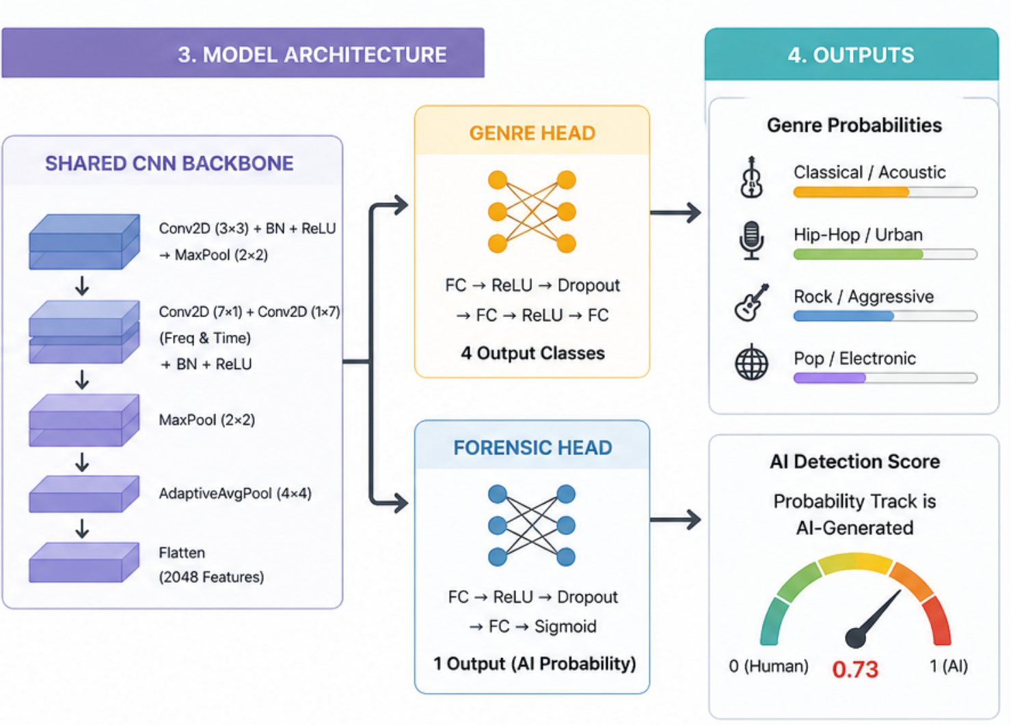
System Architecture

Slide 16
Functional Description
First conv layer: scans the spectrogram image looking for basic patterns, the same way image recognition first looks for edges and shapes
Parallel frequency + time branches: one branch reads up and down (what notes are being played), the other reads left and right (the rhythm and timing). Both run at the same time
Merging + pooling: the two branches are combined and the image is compressed down to only keep the most important features
2,048 features: by the end of the backbone, the song has been reduced to a list of 2,048 numbers that represent everything the model learned about it
Genre Head: takes those 2,048 numbers and votes across 4 genre buckets: whichever scores highest wins
Forensic Head: takes the same 2,048 numbers and produces a single score between 0 and 1, closer to 0 means human, closer to 1 means AI
The gauge showing 0.73: that's just an example, but the scale is correct: our trained model puts real human music at 0.00–0.20 and AI music at 0.40–1.00

Slide 17
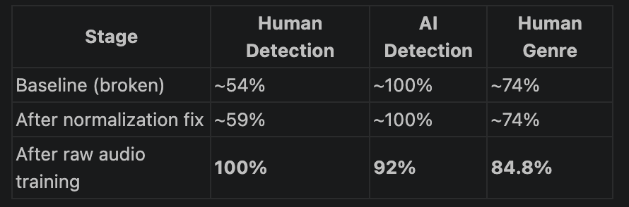

Slide 18

Sensitivity Slider
0 → threshold 0.95 → ultra-strict, misses borderline AI but zero false positives
50 (default) → threshold 0.50 → 100% human correct,100% AI correct
100 → threshold 0.05 → catches everything including borderline AI, some false positives possible

Slide 19
DEMO

Slide 20
Final Milestone Summary
Model failed completely – Classification and generation detection
Found preprocessing bug
Found pipeline mismatch”
Fixed system end to end
Clean separation and structured architecture

Slide 21
Future Improvements
Expanding results based on 30 second segments
Increasing AI dataset to improve accuracy
Differentiating similar genre classes mathematically
Implementing an assistive table to help a user choose the right percentages on the slide scale

